Slide 1
Architecture Analysis of Rice Panicle using Deep Learning
University of Engineering and Technology
Faculty Level Scientific Research Conference
Students: | Lam Thai Nguyen – K66AT Trung Kien Pham – K67MCLC
Instructors: | Dr. Tran Hiep Dinh Dr. Le Khanh Nguyen

Slide 2
TABLE OF CONTENTS
01
04
INTRODUCTION
DISCUSSION
02
05
METHODOLOGY
CONCLUSION
03
RESULTS

Slide 3
INTRODUCTION

Slide 4
Understanding Plant Phenotyping: Definition and Challenges.
Measuring and Analyzing observable, predefined traits of plants.
Rice inflorescence (Figure 1)
Panicle length
Number and order of branches
Count and sizes of grains
Definition
Traditional methods require visual inspection.
Time-consuming
Detrimental to the plant
Developed vision-based methods lack automation.
Challenges
Underscores a need for an accurate, automatic vision-based approach.

Slide 5
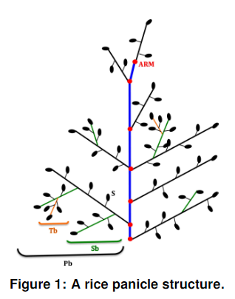
Rice panicle phenotyping involves junction detection.
Source: AL-Tam, F., Adam, H., Anjos, A.d. et al. P-TRAP: a Panicle Trait Phenotyping tool. BMC Plant Biol 13, 122 (2013). https://doi.org/10.1186/1471-2229-13-122
High-order junctions
Main axis junction

Slide 6
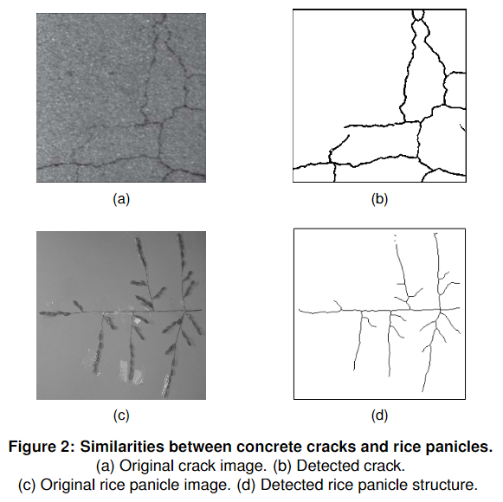
Rice panicles and concrete cracks share several similarities in their visual characteristics.
Darker than their respective backgrounds
Thin, continuous line with branching structure

Slide 7
METHODOLOGY

Slide 8
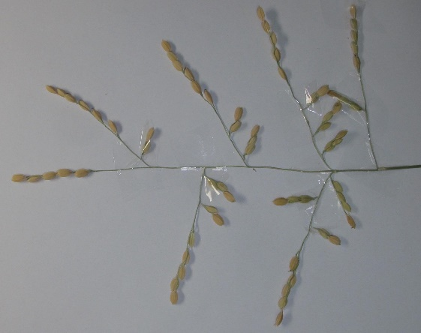
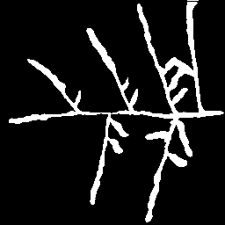
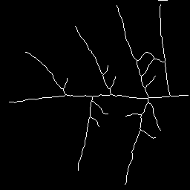
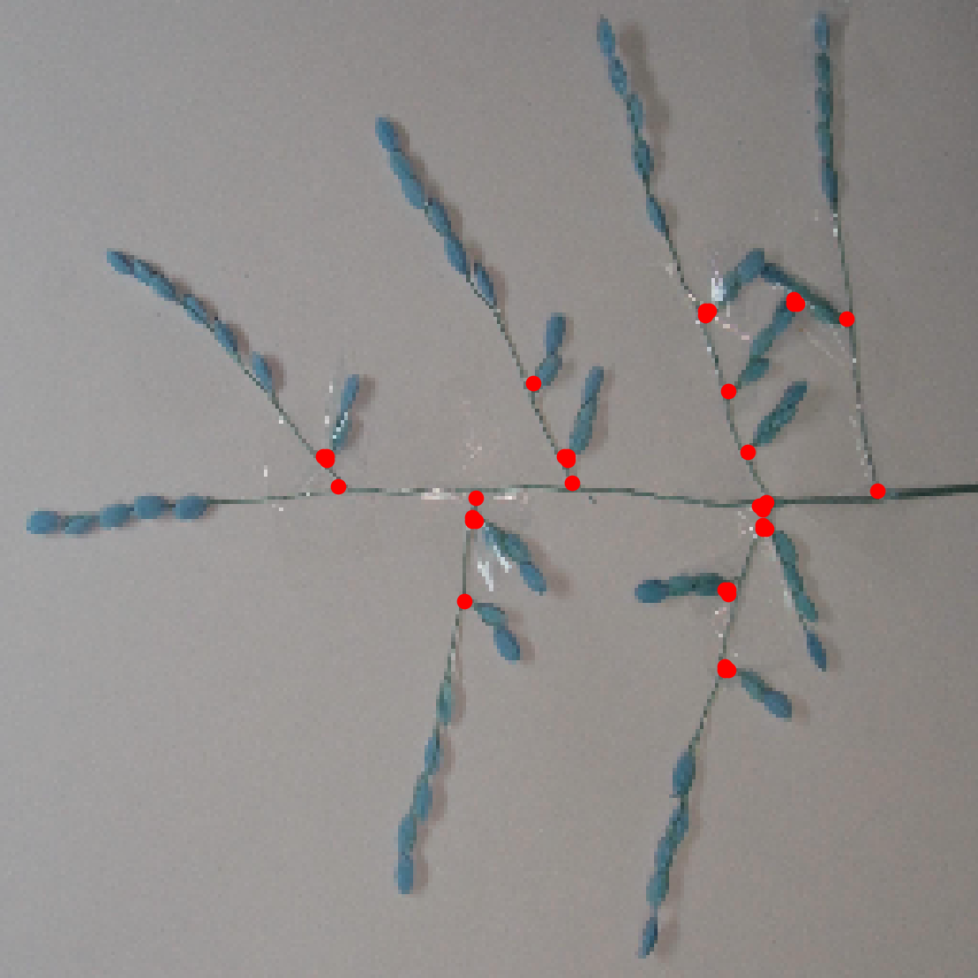
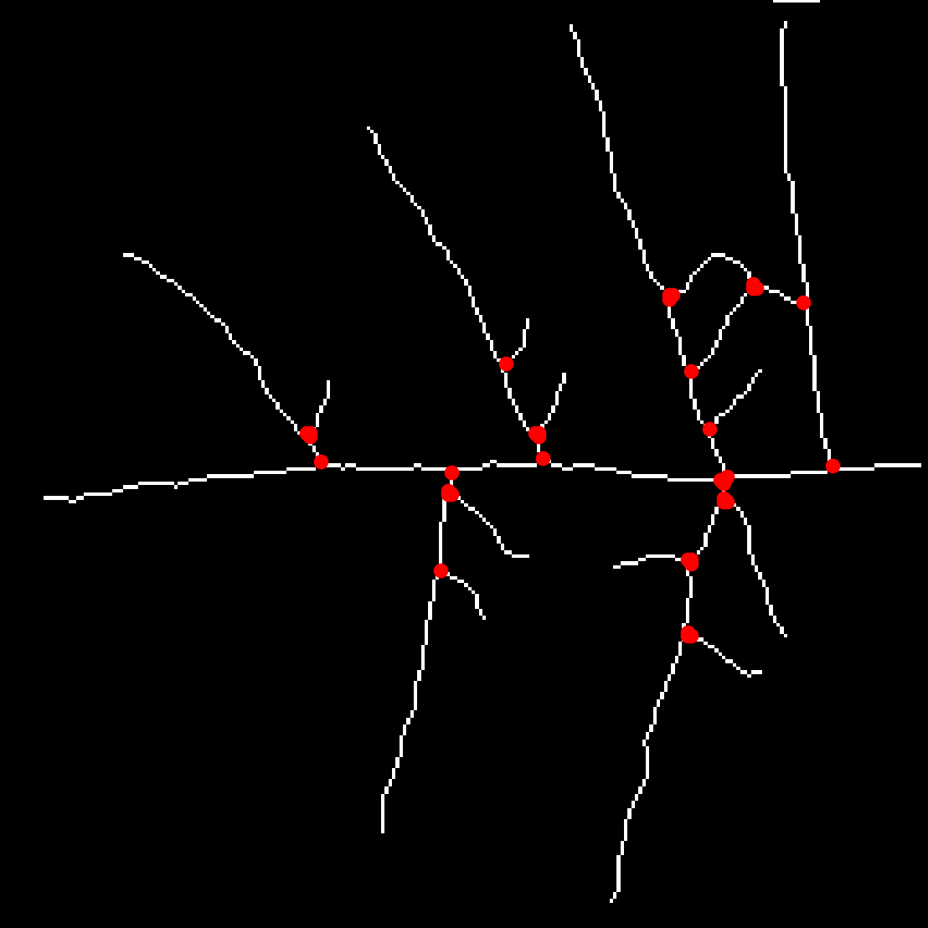
Our proposed approach.
1
2
3
Original image
Binary image
Skeleton image
5
4
Evaluation
Junction detection
Figure 3: Rice panicle junction detection process.

Slide 9
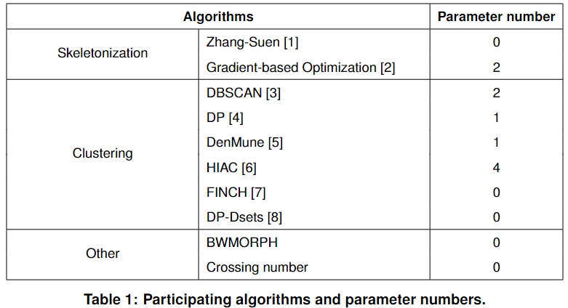
Comparison of participating algorithms in experiments.

Slide 10
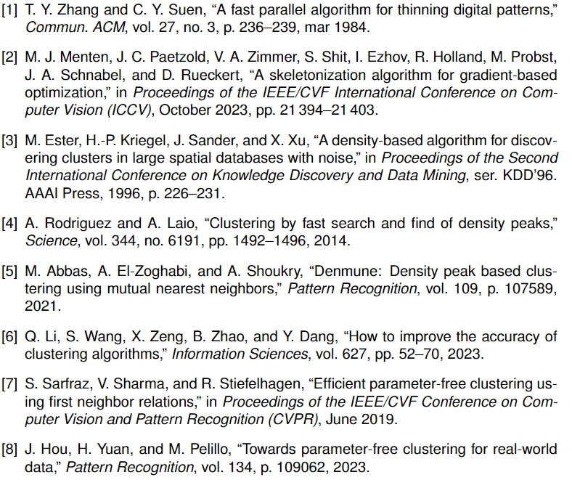
References

Slide 11
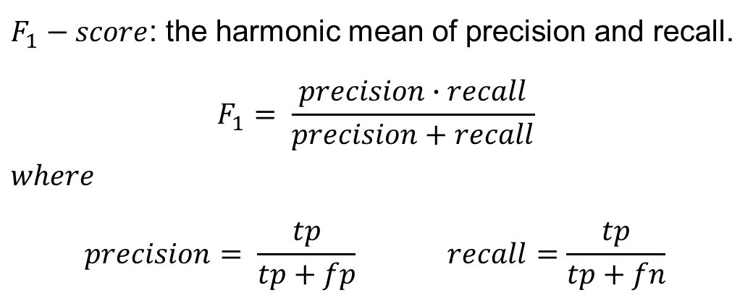
Dataset and Evaluation metrics.
Dataset
21 images featuring rice panicles originating from diverse accessions of O.Sativa, O.Glaberrima, and O.Barthii from Asia and Africa.
$F_{1}−score$: the harmonic mean of precision and recall.
$$F_{1}= \frac{precision∙recall}{precision+recall}$$
$$where$$
$$precision= \frac{tp}{tp+fp} recall=\frac{tp}{tp+fn}$$
Evaluation
Dataset source: AL-Tam, F., Adam, H., Anjos, A.d. et al. P-TRAP: a Panicle Trait Phenotyping tool. BMC Plant Biol 13, 122 (2013). https://doi.org/10.1186/1471-2229-13-122

Slide 12
RESULTS

Slide 13
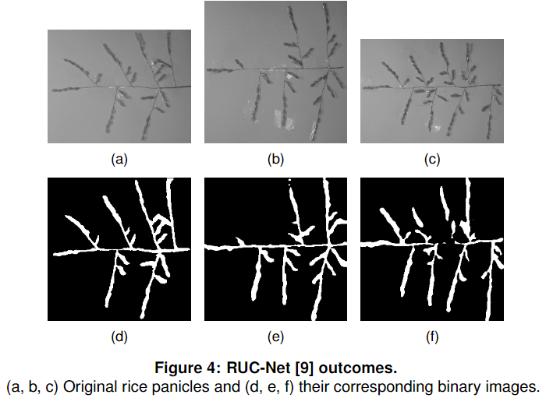
RUC-Net outcomes.
Broken branches
Overlapping branches
[9] G. Yu, J. Dong, Y. Wang, and X. Zhou, “Ruc-net: A residual-unet-based con-volutional neural network for pixel-level pavement crack segmentation,” Sensors, vol. 23, no. 1, 2023.

Slide 14
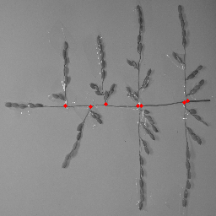
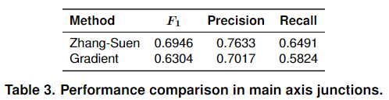
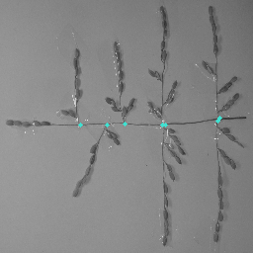
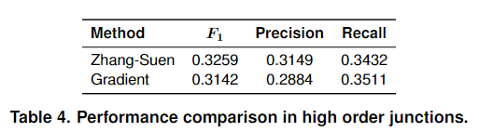
Optimal Skeletonization algorithm selection.
Predicted junction
True junction

Slide 15
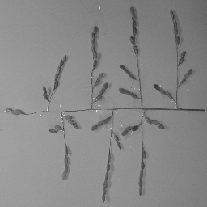
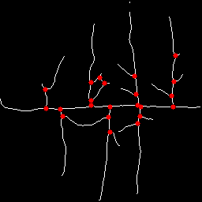


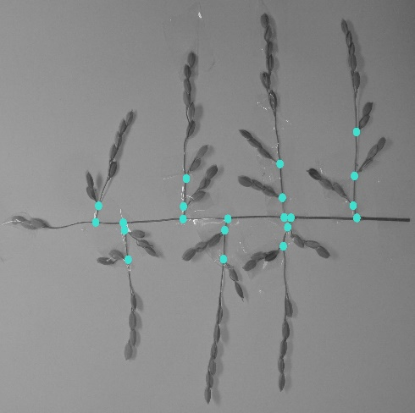
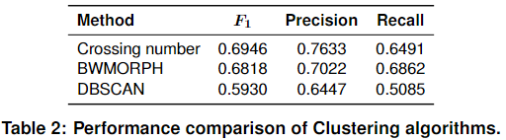



Optimal Clustering algorithms selection.
Original image
DBSCAN
$$F_{1}=0.67$$
BWMORPH
$$F_{1}=0.83$$
Crossing number
$$F_{1}=0.83$$
Ground truth
Figure 5: Qualitative results of Clustering algorithms.
Predicted junction
True junction

Slide 16
DISCUSSION

Slide 17
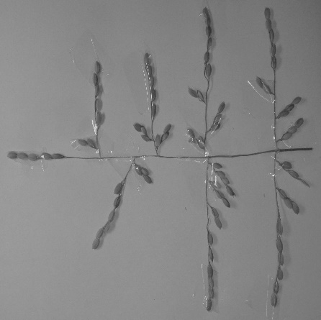
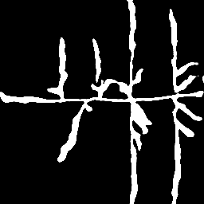
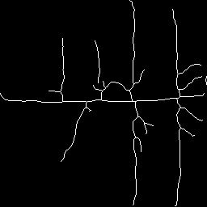
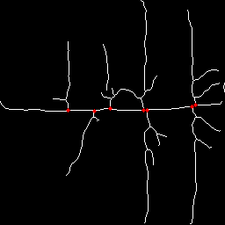
Optimal junction detection process.
1
2
3
RUC-Net
Zhang-Suen
Original image
Binary image
Skeleton image
DBSCAN
BWMORPH
Crossing number
5
4
Result
Junction detection
Figure 6: Optimal junction detection process.

Slide 18
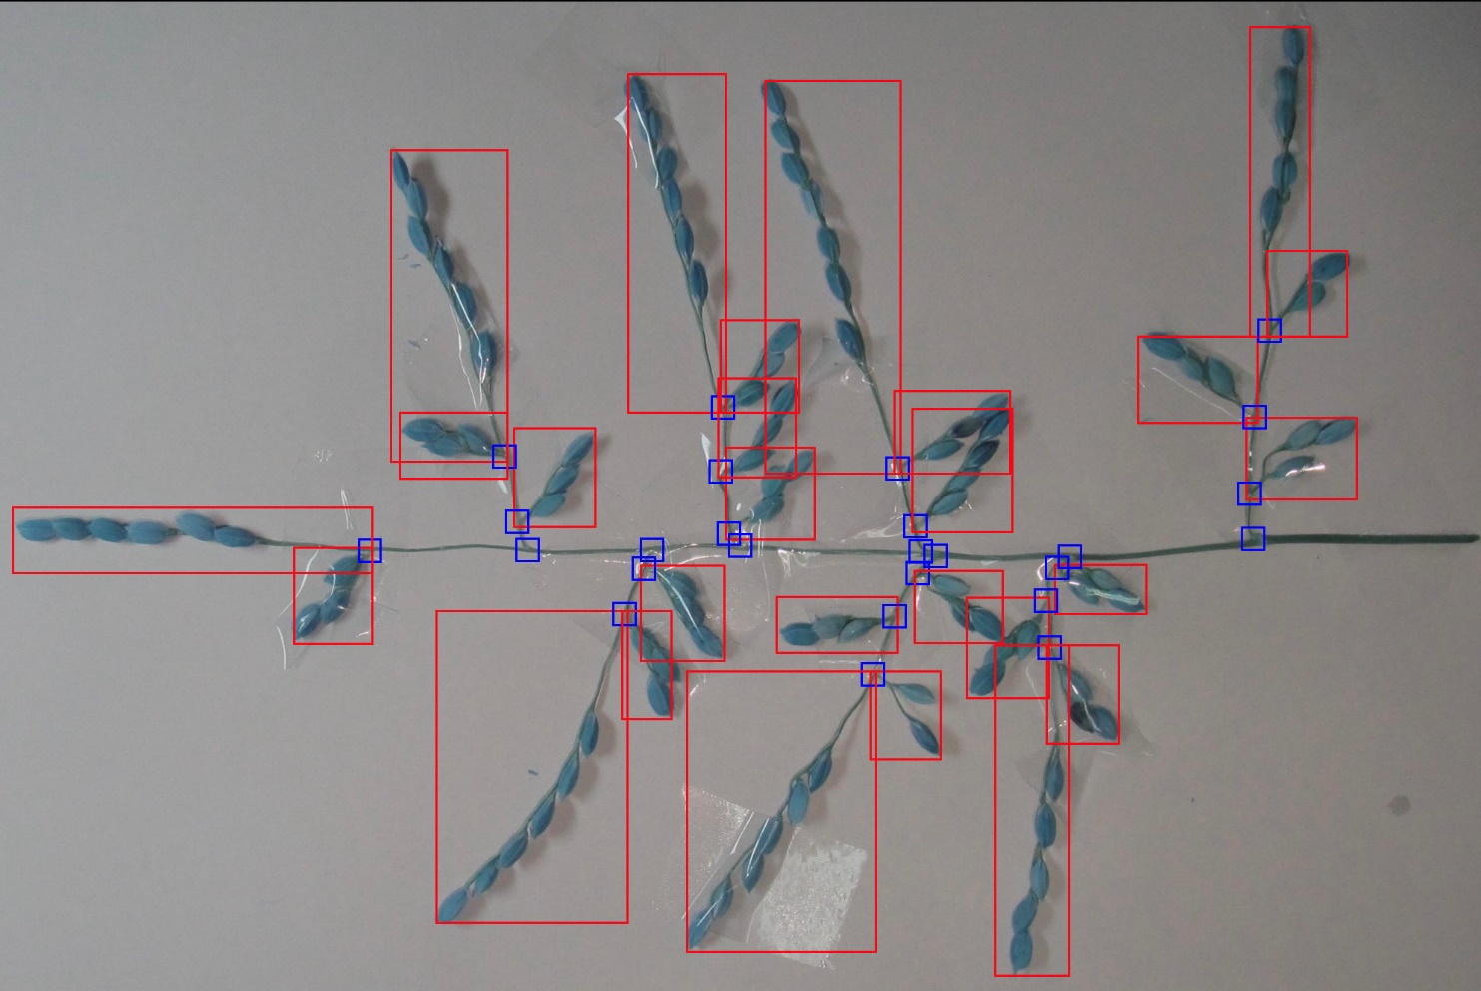
Future directions: Advancing algorithmic development.
Grain detection
Junction detection
Figure 7: Bounding boxes for rice panicle junctions and grains.

Slide 19
CONCLUSION

Slide 20
Conclusion
Approach
Automatically detecting rice panicle junctions, addressing a crucial need in plant phenotyping.
Employing a crack detection model along with image-processing techniques.
Advantages in automatic rice panicle junction detection.
Efficiency in detecting rice panicle main axis junctions.
High-order junctions require further refinement of algorithms.
Results
Fine-tuning participating algorithms for better accuracy.
Extending to rice grains/spikelets detection.
Spreading application to other plant species.
Future works

Slide 21
THANK YOU
FOR
YOUR ATTENTION

